Slide 1
Operating Systems
Deadlock Detection and Recovery

Slide 2
Deadlock Detection
If a system does not employ either a deadlock-prevention or a deadlock avoidance algorithm, then a deadlock situation may occur. In this environment, the system may provide:
An algorithm that examines the state of the system to determine whether a deadlock has occurred
An algorithm to recover from the deadlock

Slide 3
Deadlock Detection
Single Instance of Each Resource Type
Wait for graph
An edge from Pi to Pj in a wait-for graph implies that process Pi is waiting for process Pj to release a resource that Pi needs.
An edge Pi → Pj exists in a wait-for graph if and only if the corresponding resource allocation graph contains two edges Pi → Rq and Rq → Pj for some resource Rq.
A deadlock exists in the system if and only if the wait-for graph contains a cycle. To detect deadlocks, the system needs to maintain the waitfor graph and periodically invoke an algorithm that searches for a cycle in the graph.

Slide 4
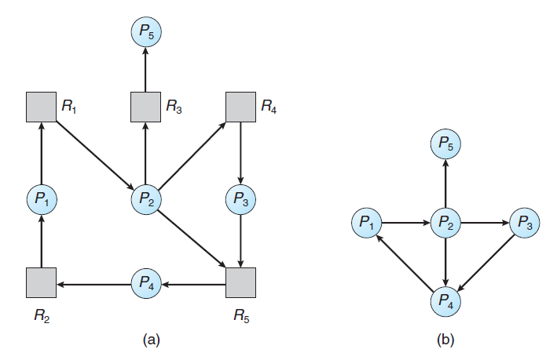
Deadlock Detection

Slide 5
Deadlock Detection
Several Instances of a Resource Type
Available. A vector of length m indicates the number of available resources of each type.
Allocation. An n × m matrix defines the number of resources of each type currently allocated to each process.
Request. An n × m matrix indicates the current request of each process.

Slide 6
Deadlock Detection
Algorithm
1. Let Work and Finish be vectors of length m and n, respectively. Initialize Work = Available. For i = 0, 1, ..., n–1, if Allocationi ̸= 0, then Finish[i] = false. Otherwise, Finish[i] = true.
2. Find an index i such that both
a. Finish[i] == false
b. Requesti ≤ Work
If no such i exists, go to step 4.
3. Work = Work + Allocationi
Finish[i] = true
Go to step 2.
4. If Finish[i] ==false for some i, 0≤i<n, then the system is in a deadlocked state. Moreover, if
Finish[i] == false, then process Pi is deadlocked

Slide 7
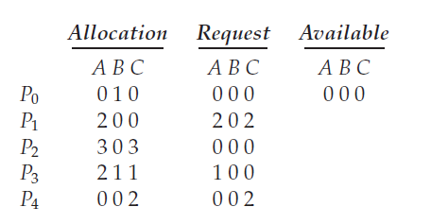
Deadlock Detection
Example
Process = P0,P1,P2,P3,P4
Resources = A,B,C

Slide 8
Deadlock Detection
Example
1.In this, Work = [0, 0, 0] &
Finish = [false, false, false, false, false]
2. i=0 is selected as both Finish[0] = false and Requesti ≤ Work
[0, 0, 0]<=[0, 0, 0].
3. Work = Work + Allocationi = [0, 0, 0]+[0, 1, 0] =>[0, 1, 0] &
Finish = [true, false, false, false, false].

Slide 9
Deadlock Detection
Example
2. i=1, Finish[0] = false and Requesti ≤ Work
[2, 0, 2]<=[0, 1, 0]. Condition is false
i=2 is selected as both Finish[2] = false and Requesti ≤ Work
[0, 0, 0]<=[0, 1, 0].
Work = Work + Allocationi = [0, 1, 0]+[3, 0, 3] =>[3, 1, 3] &
Finish = [true, false, true, false, false].

Slide 10
Deadlock Detection
Example
For i=1, Finish[0] = false and Requesti ≤ Work
[2, 0, 2]<=[3, 1, 3].
work = Work + Allocationi = [3, 1, 3]+[2, 0, 0] =>[5, 1, 3] &
Finish = [true, true, true, false, false].
For i=3, Finish[0] = false and Requesti ≤ Work
[1, 0, 0]<=[5, 1, 3].
work = Work + Allocationi = [5, 1, 3]+[2, 1, 1] =>[7, 2, 4] &
Finish = [true, true, true, true, false].

Slide 11
Deadlock Detection
Example
For i=4 Finish[0] = false and Requesti ≤ Work
[0, 0, 2]<=[7, 2, 4].
work = Work + Allocationi = [7, 2, 4]+[0, 0, 2] =>[7, 2, 6] &
Finish = [true, true, true, true, true].
If Finish[i] ==false for some i, 0≤i<n, then the system is in a deadlocked state.
Here finish[i] = all true, therefore no deadlock.

Slide 12
Deadlock Recovery
Process Termination
Abort all deadlocked processes
Abort one process at a time until the deadlock cycle is eliminated
In which order should we choose to abort?
Priority of the process
How long process has computed, and how much longer to completion
Resources the process has used
Resources process needs to complete
How many processes will need to be terminated
Is process interactive or batch?

Slide 13
Deadlock Recovery
Resource Preemption
To eliminate deadlocks using resource preemption, we successively preempt some resources from processes and give these resources to other processes until the deadlock cycle is broken.
If preemption is required to deal with deadlocks, then three issues need to be addressed:
Selecting a victim – minimize cost. Cost factors may include number of resources a deadlocked process is holding and the amount of time the process has thus far consumed.
Rollback – return to some safe state, restart process for that state
Starvation – same process may always be picked as victim, include number of rollback in cost factor

Slide 14
THANK YOU

